Slide 1
Module 3
Linear Models

Slide 2
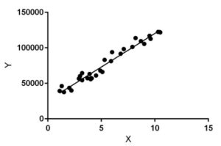
Linear Regression
Linear Regression is a machine learning algorithm based on supervised learning.
Linear regression performs the task to predict a dependent variable value (y) based on a given independent variable (x). So, this regression technique finds out a linear relationship between x (input) and y(output). Hence, the name is Linear Regression.
Hypothesis of Linear Regression is
Y = m . x + c
The model gets the best regression fit line by finding the best m (slope) and
c(intercept) values.

Slide 3
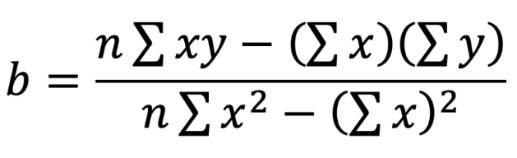
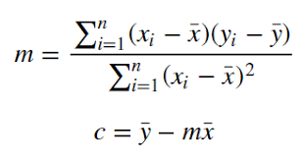
Least Square Method
The least squares method is a statistical procedure to find the best fit for a set of data points by minimizing the sum of the offsets or residuals of points from the plotted curve.
Least squares regression is used to predict the behavior of dependent variables.

Slide 4
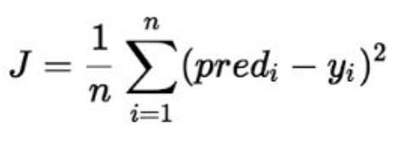
Cost Function
The model aims to predict y value such that the error difference between predicted value and true value is minimum.
Cost function(J) of Linear Regression is the Root Mean Squared Error (RMSE) between predicted y value (pred) and true y value (y).

Slide 5
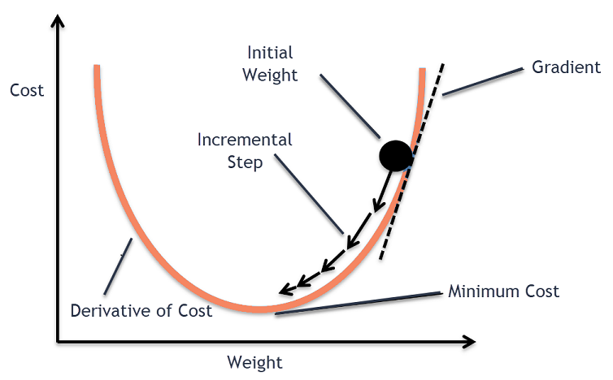
GRADIENT DESCENT IN LINEAR REGRESSION
An algorithm to minimize a loss function by optimizing the parameters
NewValue = old value – step size
Newvalue = old value – Learning Rate * slope

Slide 6
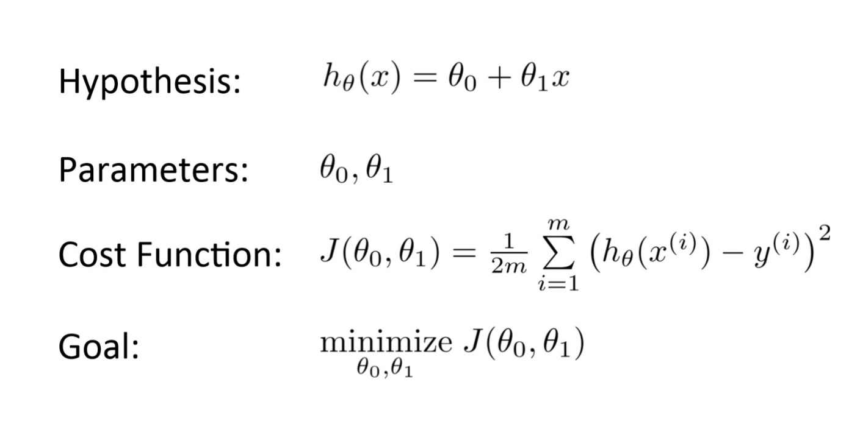
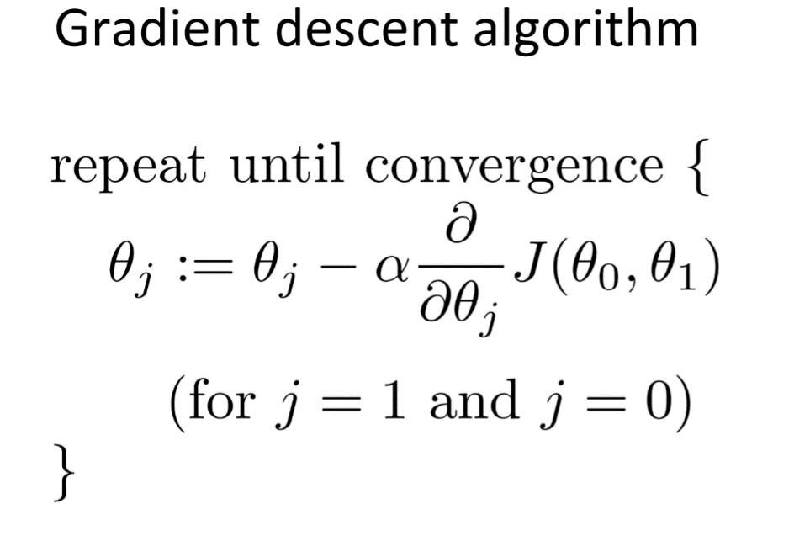
What is a Cost Function?
Linear Regression

Slide 7
Alpha- Learning rate
If the learning rate is too high, we might OVERSHOOT the minima and keep bouncing, without reaching the minima
If the learning rate is too small, the training might turn out to be too long

Slide 8
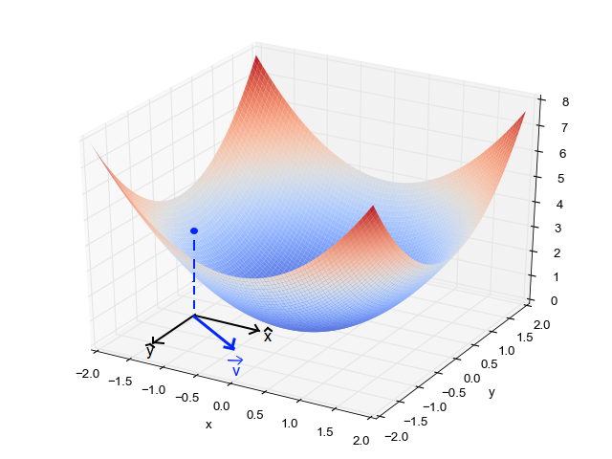
Plotting the Gradient Descent Algorithm
When we have a single parameter (theta), we can plot the dependent variable cost on the y-axis and theta on the x-axis. If there are two parameters, we can go with a 3-D plot, with cost on one axis and the two parameters (thetas) along the other two axes.

Slide 9
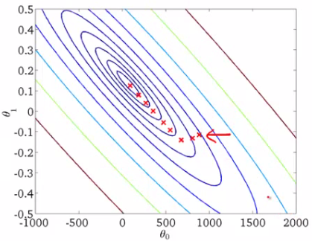
Plotting the Gradient Descent Algorithm

Slide 10
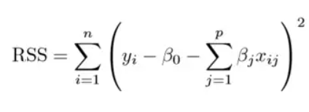

Regularization in ML
Problem : Overfitting
Solution : This is a form of regression, that constrains/ regularizes or shrinks the coefficient estimates towards zero. In other words, this technique discourages learning a more complex or flexible model, so as to avoid the risk of overfitting.
A simple Linear Regression
Y = mx + c

Slide 11
Regression Regularization
If there is noise in the training data, then the estimated coefficients won’t generalize well to the future data. This is where regularization comes in and shrinks or regularizes these learned estimates towards zero.

Slide 12
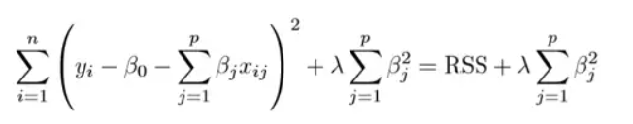
Ridge Regression
RSS is modified by adding the shrinkage quantity.
λ is the tuning parameter that decides how much we want to penalize the flexibility of our model.
It adds a factor of sum of squares of coefficients in the optimization objective. Thus, ridge regression optimizes the following:
Objective = RSS + α * (sum of square of coefficients)
The coefficient estimates produced by this method are also known as the L2 norm.
Performs L2 regularization, i.e. adds penalty equivalent to square of the magnitude of coefficients

Slide 13
Ridge Regression
Objective = RSS + α * (sum of square of coefficients)
α = 0:
The objective becomes same as simple linear regression.
We’ll get the same coefficients as simple linear regression.
α = ∞:
The coefficients will be zero. Why? Because of infinite weightage on square of coefficients, anything less than zero will make the objective infinite.
0 < α < ∞:
The magnitude of α will decide the weightage given to different parts of objective.
The coefficients will be somewhere between 0 and ones for simple linear regression.

Slide 14
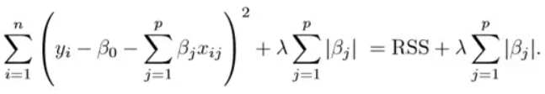
LASSO
this variation differs from ridge regression only in penalizing the high coefficients.
It uses |βj|(modulus)instead of squares of β, as its penalty. In statistics, this is known as the L1 norm.
Lasso regression performs L1 regularization, i.e. it adds a factor of sum of absolute value of coefficients in the optimization objective. Thus, lasso regression optimizes the following:
Objective = RSS + α * (sum of absolute value of coefficients)

Slide 15
LASSO
Like that of ridge, α can take various values. Lets iterate it here briefly
α = 0: Same coefficients as simple linear regression
α = ∞: All coefficients zero (same logic as before)
0 < α < ∞: coefficients between 0 and that of simple linear regression

Slide 16
What is Hyperplane ??
For a linearly separable dataset having n features , a hyperplane is basically an (n – 1) dimensional subspace used for separating the dataset into two sets, each set containing data points belonging to a different class.
For example, for a dataset having two features X and Y (therefore lying in a 2-dimensional space), the separating hyperplane is a line (a 1-dimensional subspace).
Similarly, for a dataset having 3-dimensions, we have a 2-dimensional separating hyperplane, and so on.
In machine learning, Support Vector Machine (SVM) is a non-probabilistic, linear, binary classifier used for classifying data by learning a hyperplane separating the data.

Slide 17
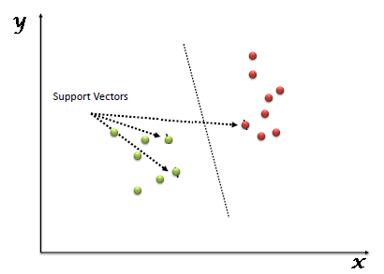
What is SVM ?
SVM was developed by Vladimir Vapnik in the 1970s
Vapnik envisaged that coming up with a decision boundary that tries to maximize the margin between the two classes will give great results and overcome the problem of overfitting.
In the SVM algorithm, we plot each data item as a point in n-dimensional space (where n is a number of features you have) .Then, we perform classification by finding the hyper-plane that differentiates the two classes.
kernel method was introduced that made it possible to solve non-linear problems using SVM.

Slide 18
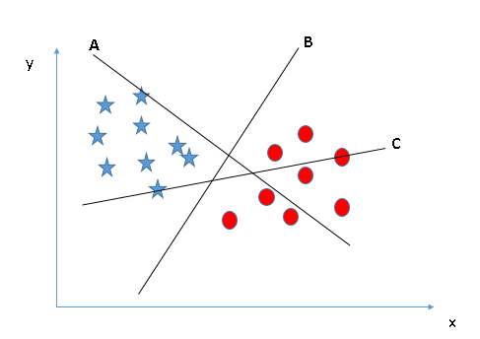
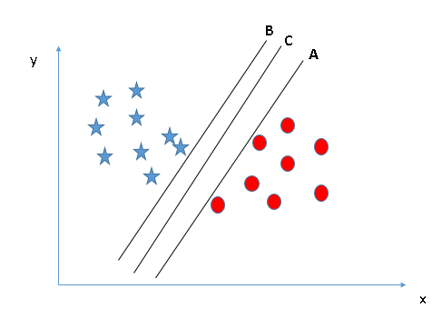
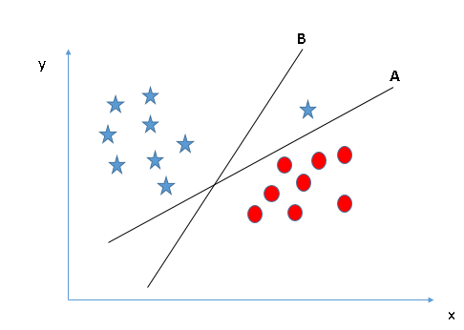
Find the right Hyperplane Scenario ?

Slide 19

Margin (maximum)
Our objective is to find a plane that has the maximum margin, i.e the maximum distance between data points of both classes.
Support vectors are data points that are closer to the hyperplane and influence the position and orientation of the hyperplane.
These margins are calculated using data points known as Support Vectors.
OR
Support Vectors are those data points that are near to the hyper-plane and help in orienting it.

Slide 20
Algorithm Intuition of SVM
In SVM, we take the output of the linear function and if that output is greater than 1, we identify it with one class and if the output is -1, we identify is with another class.
Step 1: SVM algorithm predicts the classes. One of the classes is identified as 1 while the other is identified as -1.

Slide 21
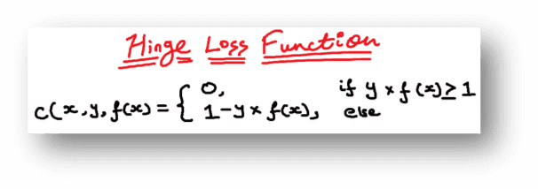
Step 2
convert the problem into a mathematical equation involving unknowns. These unknowns are then found by converting the problem into an optimization problem.
As optimization problems always aim at maximizing or minimizing something while looking and tweaking for the unknowns, in the case of the SVM classifier, a loss function known as the hinge loss function is used and tweaked to find the maximum margin.

Slide 22
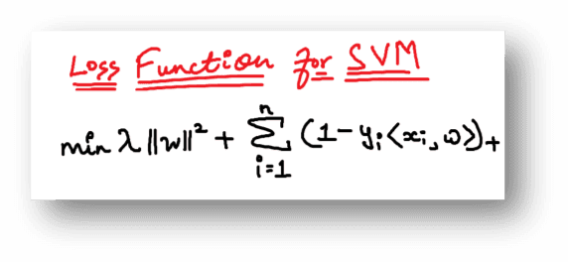
Step 3: Loss function
If cost function is zero no class is predicted incorrectly
The problem is that there is a trade-off between maximizing margin and the loss generated if the margin is maximized to a very large extent. To bring these concepts in theory, a regularization parameter is added.

Slide 23
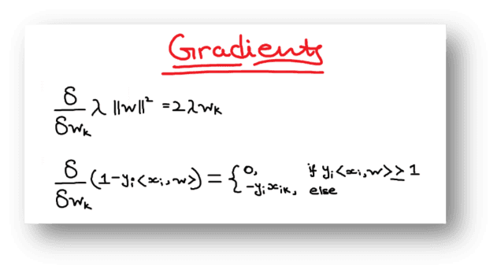
Step 4: Partial derivative
we take partial derivatives with respect to the weights to find the gradients. Using the gradients, we can update our weights.

Slide 24
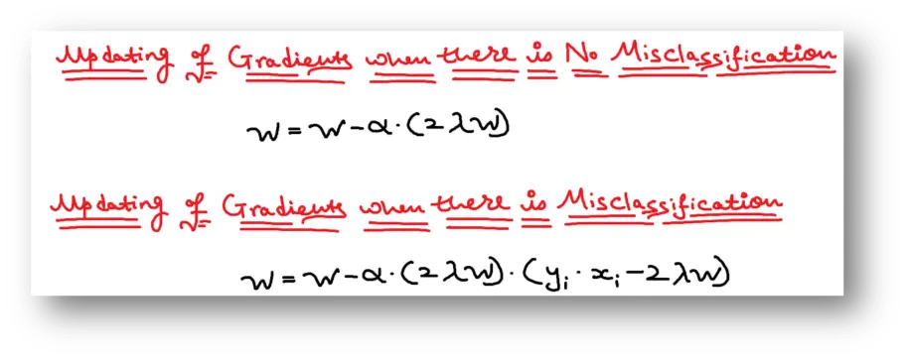
Step 5: Update weight
When there is no misclassification, i.e our model correctly predicts the class of our data point, we only have to update the gradient from the regularization parameter.
When there is a misclassification, i.e our model make a mistake on the prediction of the class of our data point, we include the loss along with the regularization parameter to perform gradient update.

Slide 25
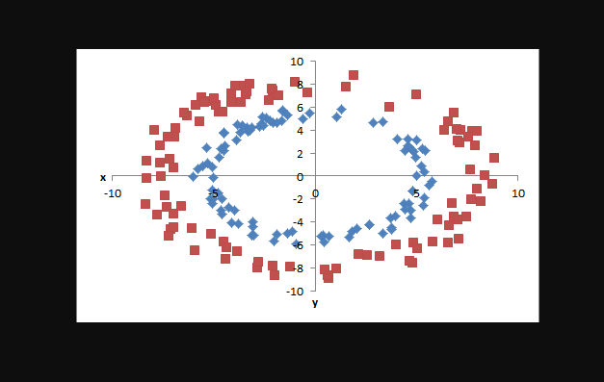
Introduction to kernels
When we can easily separate data with hyperplane by drawing a straight line is Linear SVM.
When we cannot separate data with a straight line we use Non – Linear SVM. In this, we have Kernel functions
It transforms data into another dimension so that the data can be classified.
It transforms two variables x and y into three variables along with z.

Slide 26
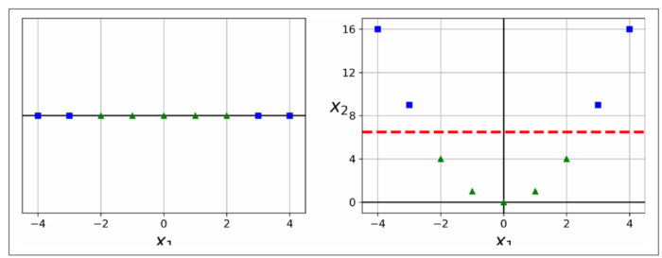
Kernel Trick
Datasets are which you will be working or currently working on might not always be linear. One approach to handling nonlinear datasets is to add more features, such as polynomial features; in some cases, this can result in a linearly separable dataset.
Consider the left plot in Figure 1: it represents a simple dataset with just one feature x1. This dataset is not linearly separable, as you can see. But if you add a second feature x2 = (x1)2, the resulting 2D dataset is perfectly linearly separable.

Slide 27

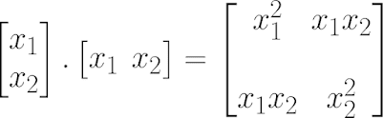
Polynomial Kernel
A polynomial kernel is a kind of SVM kernel that uses a polynomial function to map the data into a higher-dimensional space. It does this by taking the dot product of the data points in the original space and the polynomial function in the new space.
The important terms we need to note are x1, x2, x1^2, x2^2, and x1 * x2. When finding these new terms, the non-linear dataset is converted to another dimension that has features x1^2, x2^2, and x1 * x2.

Slide 28
RBF Kernel
the Squared Euclidean Distance is multiplied by the gamma parameter and then finding the exponent of the whole.

